Slide 1
Velocity Matching
Useful when combined with other behaviours
e.g. flocking
Base on arrive behaviour

Slide 2
Velocity Matching
steering = new SteeringOutput()
timeToTarget = 0.1
steering.linear = target.velocity - my.velocity
steering.linear = steering.linear / timeToTarget
if steering.linear.length > maxAcceleration:
steering.linear.normalize
steering.linear = steering.linear * maxAcceleration
steering.angular = 0
return steering

Slide 3
Basic Steering Behaviours
Seek, align and velocity matching form the basic behaviour set
Other behaviours are based on these
Delegation!

Slide 4
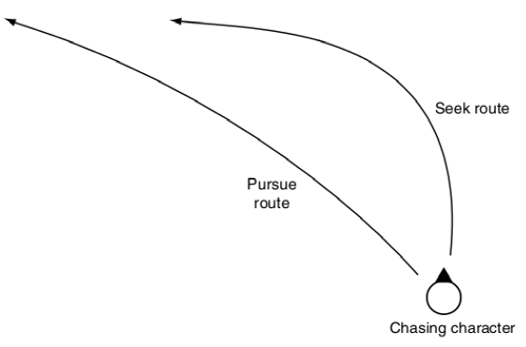
Pursue and Evade
When chasing a target it is sometimes best to aim not where the target is but where it is going
An intercept course
Calculate where it will be when we arrive
aim for that spot
use seek to new location
We need to be able to predict where it will be

Slide 5
Pursue
direction = target.position - my.position
distance = direction.length
speed = my.velocity.length
if speed <= distance / maxTimePrediction:
timePrediction = maxTimeprediction
else:
timePrediction = distance/speed
newtarget.position = target.position + target.velocity * timePrediction
seek(me, newTarget)
or if we encapsulate this code in a Pursue function:
return seek(me, newTarget)

Slide 6
Issues
We can overshoot if we move faster than target
Use arrive instead of seek
We can run ahead of target

Slide 7
Evade
same except use flee not seek!
return flee(me, newTarget)

Slide 8
Face Behaviour
Look towards target
Calculate the target orientation
Delegate to the align function to perform the rotation
direction = target.position - my.position
if direction.length = 0: skip
else:
newTarget = target
newTarget.Orientation = atan2(-direction.x,direction.z)
align(newTarget)

Slide 9
Look where you go
look in direction of travel
if my.velocity = 0: skip
else:
target.orientation = atan2(my.velocity.x, my.velocity.z)
align(target)

